Slide 1
BAGIAN BACKEND

Slide 2
TEKNOLOGI YANG DIGUNAKAN
SPRING JAVA
Pertama kali ditulis dan dirilis oleh Rod Johnson dengan lisensi Apache 2.0 pada bulan Juni 2003.
Kelebihan Spring Java :
Mature
Lighthweight
Support Framework
Good API Design
Backward Compatible

Slide 3
STRUKTUR SPRING FRAMEWORK
Spring
Model
Controller
Service
Mapper

Slide 4
ENTITAS/SUB FEATUR EMAIL NOTIFICATION
EMAIL SENDER
Digunakan untuk mengolah email sender atau email yang akan digunakan untuk mengirim email.
Fasilitas yang disediakan
Insert Data
Edit Data

Slide 5
API & JSON
API input email sender
http://localhost:8080/tenancy-management/api/sender/create
JSON :
{
"email": "cobapaska@gmail.com",
"password": "cobapaska123",
"host": "smtp.gmail.com",
"port": 465,
"ssl": true,
"active": true
}
API edit email sender
http://localhost:8080/tenancy-management/api/sender/edit
API delete email sender
http://localhost:8080/tenancy-management/api/sender/delete/{emailSenderId}
API Get All
http://localhost:8080/tenancy-management/api/sender/list
JSON :
{
"id" :1,
"email": "cobapaska@gmail.com",
"password": "cobapaska123",
"host": "smtp.gmail.com",
"port": 465,
"ssl": true,
"active": true
}
API Get by Id
http://localhost:8080/tenancy-management/api/sender/ {emailSenderId}
API Get by Active
http://localhost:8080/tenancy-management/api/sender/active

Slide 6
EMAIL CATEGORY
Digunakan untuk mengolah email category yang nantinya digunakan sebagai identitas untuk mengkategorikan email.
Fasilitas yang disediakan
Insert Data
Edit Data
Delete Data

Slide 7
API & JSON
API Insert email template category
http://localhost:8080/tenancy-management/api/email-template-category/create
JSON :
{
“id”:1,
"categoryName":"Big",
"description":"besar",
"active":true
}
API edit email template category
http://localhost:8080/tenancy-management/api/email-template-category/edit
Delete email template category
http://localhost:8080/tenancy-management/api/email-template-category/delete/{emailTemCategoryId}
Get all
http://localhost:8080/tenancy-management/api/email-template-category/list
Get by Id
http://localhost:8080/tenancy-management/api/email-template-category/{emailTemCategoryId}
Get by Active
http://localhost:8080/tenancy-management/api/email-template-category/active

Slide 8
EMAIL TEMPLATE
Digunakan untuk mengolah email template yang kemudian dapat dikirim oleh user berulang kali. Email tujuan atau penerima dari email ini hanya email-email yang terdaftar di contact person dari customer yang telah berlangganan.
Fasilitas yang disediakan
Insert Data
Edit Data
Delete Data

Slide 9
API & JSON
API insert email template
http://localhost:8080/tenancy-management/api/email-template/create
JSON :
{
"templateName" : "template baru",
"subject" : "template baru subject",
"body" : "ceritanya ini body. coba ajalah ya. Siapa tau beruntung hehe",
"emailTemplateCategoryId" : 1,
"senderId" : 3,
"appId" : 3,
"recipient" : "paskaanugrah1@gmail.com, paskaanugrah123@gmail.com"
}
API send email template
http://localhost:8080/tenancy-management/api/email-template/send/{emailTemplateId}
API edit email template
http://localhost:8080/tenancy-management/api/email-template/edit
API delete email template
http://localhost:8080/tenancy-management/api/email-template/delete/{emailTemplateId}
API get All
http://localhost:8080/tenancy-management/api/email-template/list
API get by Id
http://localhost:8080/tenancy-management/api/email-template/{id}

Slide 10
EMAIL HISTORY
Merupakan log yang digunakan untuk menyimpan email yang telah dikirim oleh User baik yang berhasil maupun gagal.

Slide 11
API & JSON
API insert atau send email
http://localhost:8080/tenancy-management/api/email-history/send
JSON :
{
"toRecipient" : "oeyeoy@gmail.com",
"bcc" : "paskaadil@gmail.com",
"cc" : "ulfaintania1@gmail.com",
"subject" : "ini tls - Coba send e-mail",
"body" : "yeay berhasil!!",
"senderId" : 3
}
API get All
http://localhost:8080/tenancy-management/api/email-history/list
API get by Id
http://localhost:8080/tenancy-management/api/email-history/{emailHistoryId}

Slide 12
HOW TO usE THIS FEATURE ?

Slide 13
Insert Master Parameter
Write Email
Send Email

Slide 14
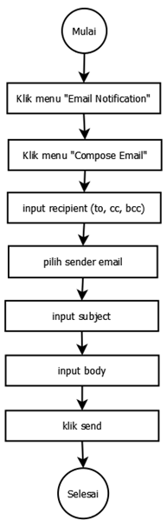
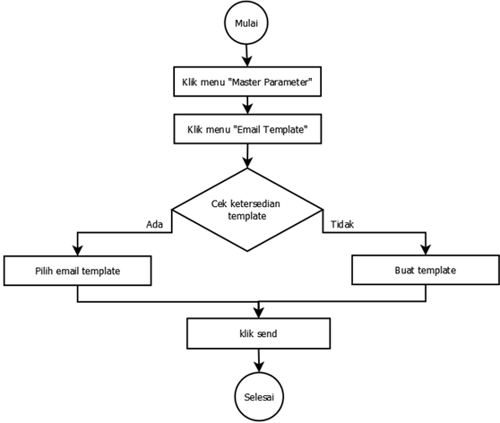
Compose Email
Send Using Email Template

